Slide 1
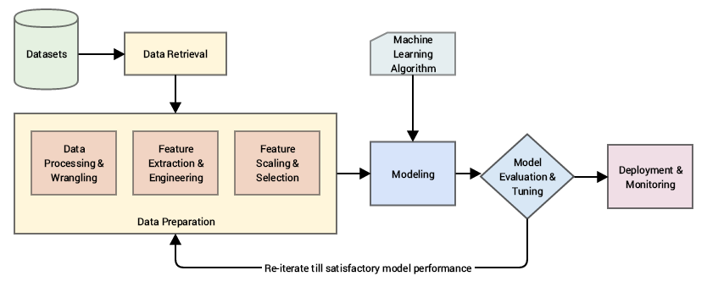

Slide 2
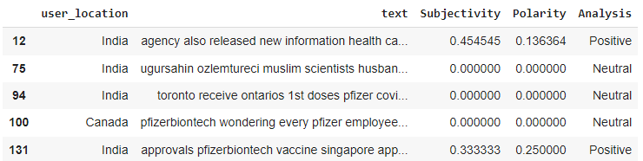
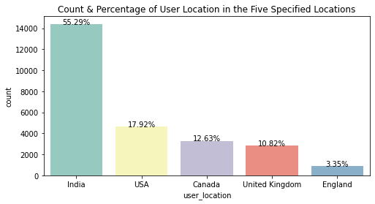
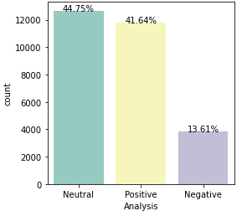
a
Python output from data preprocessing step
Count & percentage of pos, neu and neg
sentiments for the 5 countries
b
Count & percentage of user location in the dataset
c

Slide 3

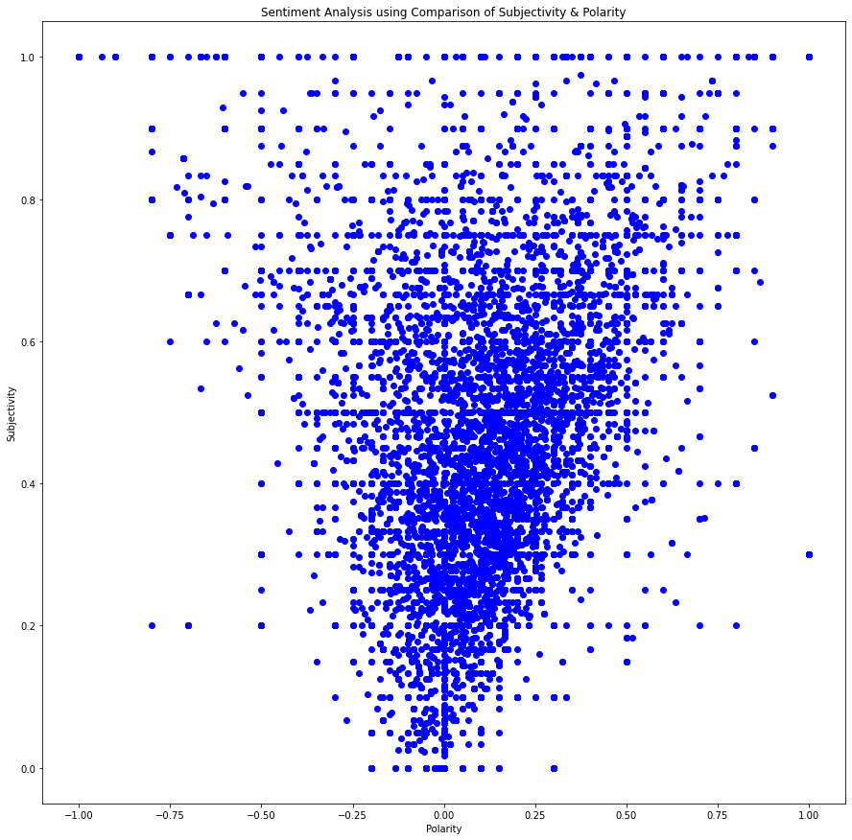
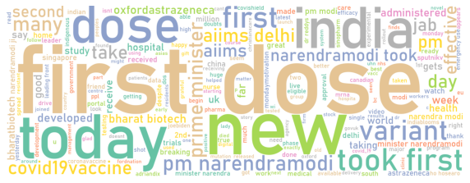
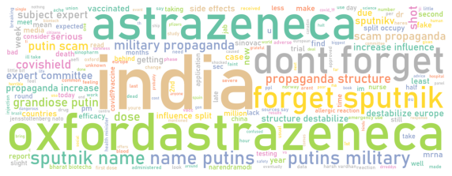
a
d
Sentiment Analysis using Comparison of Subjectivity & Polarity
b
Subjectivity
c
Polarity

Slide 4
a
Precision and recall curves
b
ROC curves

